Slide 1
Securing the Internet of Medical Things (IoMT)
● Cybersecurity challenges in connected healthcare,
pacemakers, and hospital networks.
2026
Aaditya Vishwakarma

Slide 2
Aaditya Vishwakarma
Introduction
Securing the Internet of Medical Things (IoMT)
What is IoMT?
The Internet of Medical Things (IoMT) is a network of connected medical devices, healthcare equipment, and software systems that collect, transmit, and process medical data. It enables remote patient monitoring, smart healthcare services, and efficient hospital management.
Examples of IoMT Devices:
❤️ Smart Pacemakers — Monitor and help regulate heart rhythms.
⌚ Wearable Health Devices — Track heart rate, oxygen levels, and other health measurements.
💉 Connected Insulin Pumps — Deliver insulin according to configured treatment requirements.
🏥 Patient Monitoring Systems — Monitor patients' vital signs.
🩻 Connected Medical Equipment — Includes network-connected scanners and diagnostic systems.
Why Is IoMT Security Important?
Protects confidential patient information.
Prevents unauthorized access to medical devices.
Helps maintain the reliability of hospital networks.
Reduces the risk of healthcare service disruption.
Supports patient safety and data integrity.

Slide 3
Problem Statement
Cybersecurity Challenges in Connected Healthcare
Modern healthcare systems rely on connected medical devices and hospital networks to monitor patients and manage sensitive medical information. However, inadequate security controls can expose these systems to cyberattacks, unauthorized access, and service disruptions.
Major Problems
Unauthorized Device Access: Attackers may attempt to access connected medical devices and healthcare systems.
Patient Data Breaches: Sensitive medical records may be exposed, stolen, or modified.
Pacemaker Security Risks: Vulnerabilities in connected cardiac devices or their communication systems may create potential patient-safety risks.
Hospital Network Attacks: Malware and ransomware can disrupt hospital operations and access to medical records.
Outdated Medical Devices: Legacy software and delayed security updates can leave known vulnerabilities unaddressed.
Service Disruption: Cybersecurity incidents can affect the availability and reliability of essential healthcare services.
Research Problem
How can cybersecurity mechanisms protect connected medical devices, patient information, and hospital networks while maintaining the safety, reliability, and availability of healthcare services?

Slide 4
Aaditya Vishwakarma
Research Objectives
Securing the Internet of Medical Things (IoMT)
Objectives of the Study
Understand IoMT: Study the architecture, applications, and importance of connected medical devices in healthcare.
Identify Cybersecurity Threats: Examine risks such as malware, ransomware, unauthorized access, and data breaches.
Analyse Medical Device Security: Investigate security challenges associated with connected pacemakers, wearable devices, and patient-monitoring systems.
Protect Patient Data: Explore encryption, authentication, and access-control mechanisms for safeguarding sensitive medical information.
Secure Hospital Networks: Examine network segmentation, intrusion detection, and continuous security monitoring.
Propose Security Solutions: Develop a layered cybersecurity framework to improve IoMT security while maintaining patient safety.
Research Goal
To strengthen the security, privacy, reliability, and availability of connected healthcare systems while protecting patients and their medical data.

Slide 5
Aaditya Vishwakarma
Securing the Internet of Medical Things (IoMT)
Existing security techniques help protect connected medical devices, patient information, and hospital networks from cyber threats.
1. Data Encryption 🔐
Protects sensitive medical information during transmission and storage, reducing the risk of unauthorized disclosure.
2. Authentication and Access Control 🔑
Ensures that only authorized users and devices can access healthcare systems and medical information.
3. Network Segmentation 🌐
Separates medical devices from guest Wi-Fi and other hospital networks to limit unauthorized access and the spread of attacks.
4. Intrusion Detection Systems (IDS) 🛡️
Monitor network traffic and identify suspicious activities that may indicate cyberattacks.
5. Security Updates and Patch Management ⚙️
Addresses known software and firmware vulnerabilities in connected medical devices and hospital systems.
6. Multi-Factor Authentication (MFA) 👤
Adds additional verification when authorized personnel access sensitive healthcare applications and administrative systems.
Existing Security Techniques

Slide 6
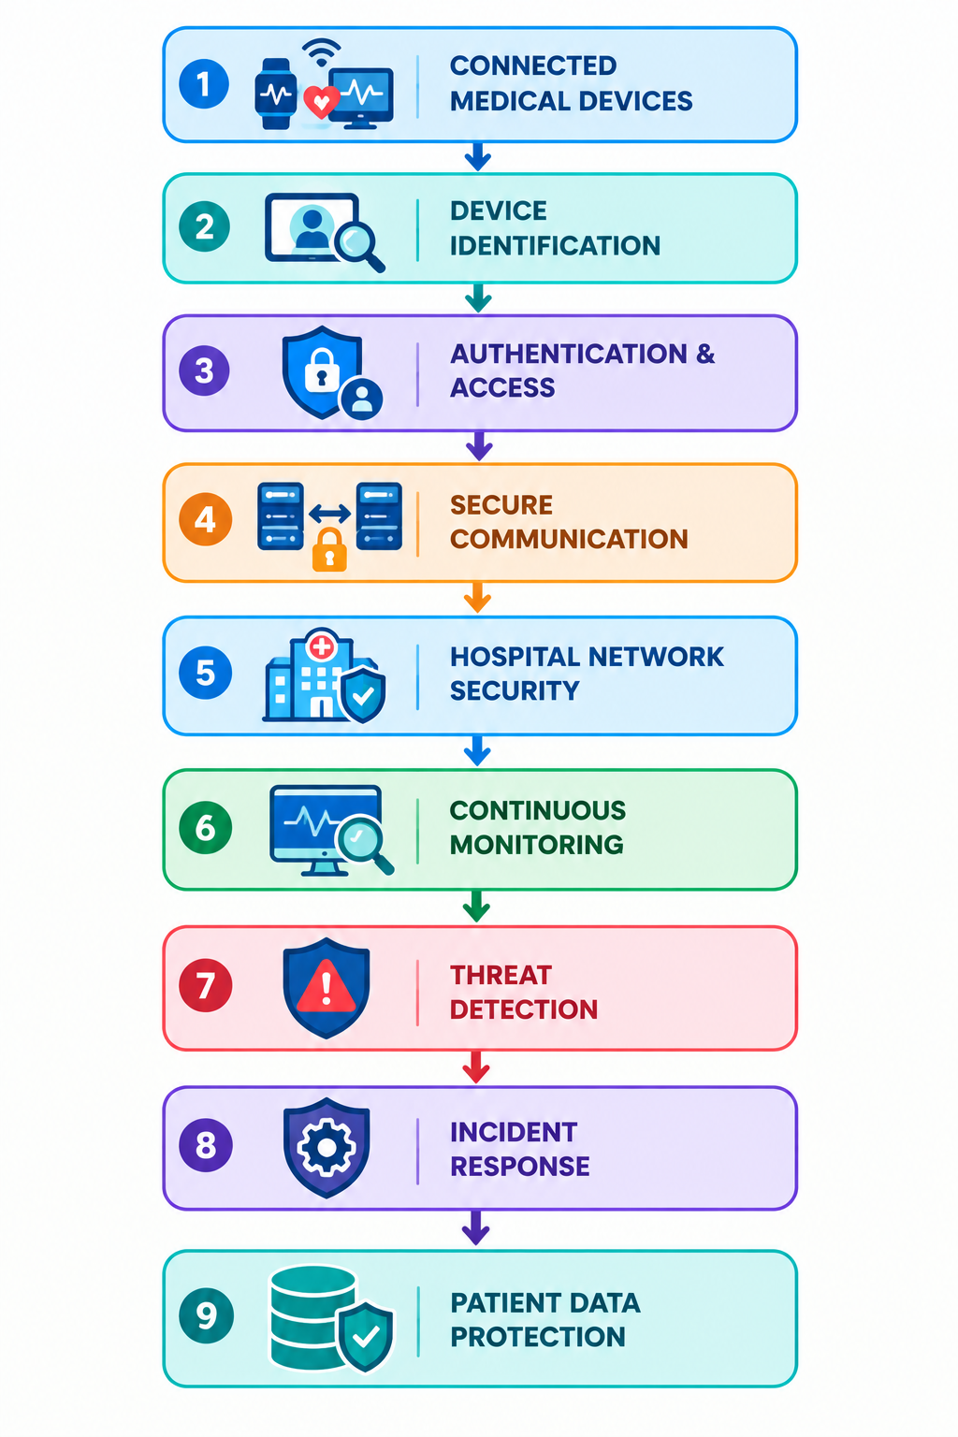
Aaditya Vishwakarma
Proposed Approach
Proposed IoMT Cybersecurity Framework
The proposed approach uses a layered security framework to protect connected medical devices, pacemakers, patient information, and hospital networks from cybersecurity threats.
Key Components
Device Identification: Identify connected medical devices and monitor their network access.
Authentication & Access: Restrict access to authorized users and devices.
Secure Communication: Use encryption to protect sensitive medical information.
Network Security: Separate medical devices from unrelated hospital network segments.
Continuous Monitoring: Monitor network traffic and security logs for suspicious activity.
Threat Detection: Identify potential cyberattacks and abnormal device behaviour.
Incident Response: Investigate threats and respond without unnecessarily disrupting essential medical services.

Slide 7
Tools and Technologies
Aaditya Vishwakarma
Securing the Internet of Medical Things (IoMT)
1. Wireshark — Network Traffic Analysis
Analyses network packets to identify communication patterns and investigate suspicious network activity.
2. Nmap — Network Discovery
Identifies devices and services on authorized test networks to help assess network exposure.
3. Suricata — Intrusion Detection
Detects suspicious network traffic using security rules and protocol analysis.
4. Wazuh — Security Monitoring
Collects and analyses available security logs to identify potential threats and suspicious events.
5. Python — Security Automation
Supports the development of prototypes for log analysis, threat detection, and anomaly identification.
6. OpenSSL — Cryptographic Testing
Demonstrates cryptographic operations and helps test secure communication configurations.
Important Technologies
Encryption: Protects sensitive medical data.
Authentication: Verifies users and devices.
Network Segmentation: Isolates medical devices from unrelated network traffic.
IDS/IPS: Detects and, where appropriate, blocks suspicious activity.
SIEM: Collects and correlates security events.

Slide 8
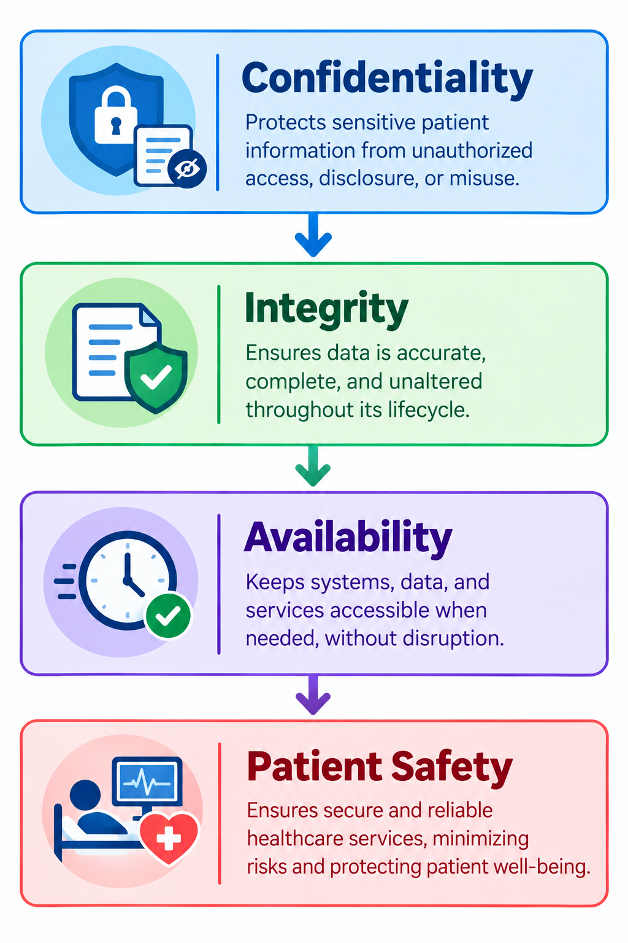
Aaditya Vishwakarma
Security Challenges and Implications
Cybersecurity Risks in Connected Healthcare
1. Pacemaker Security Risks
Unauthorized access to connected cardiac devices or their communication systems.
Potential interference with device monitoring or configuration.
Requires strong security controls that preserve patient safety.
2. Patient Data Breaches
Theft or exposure of confidential medical records.
Unauthorized access to personal and health information.
Risks to patient privacy and data integrity.
3. Hospital Network Attacks
Ransomware and malware infections.
Disruption of hospital systems and medical services.
Unauthorized access to connected medical equipment.
4. Vulnerable Medical Devices
Outdated software and firmware.
Delayed security patches due to compatibility or safety requirements.
Limited processing power in some connected devices.
5. Availability and Patient Safety
Network failures can interrupt access to essential healthcare systems.
Inappropriate security controls may disrupt legitimate medical communication.
Incident response must prioritize patient safety and continuity of care.

Slide 9
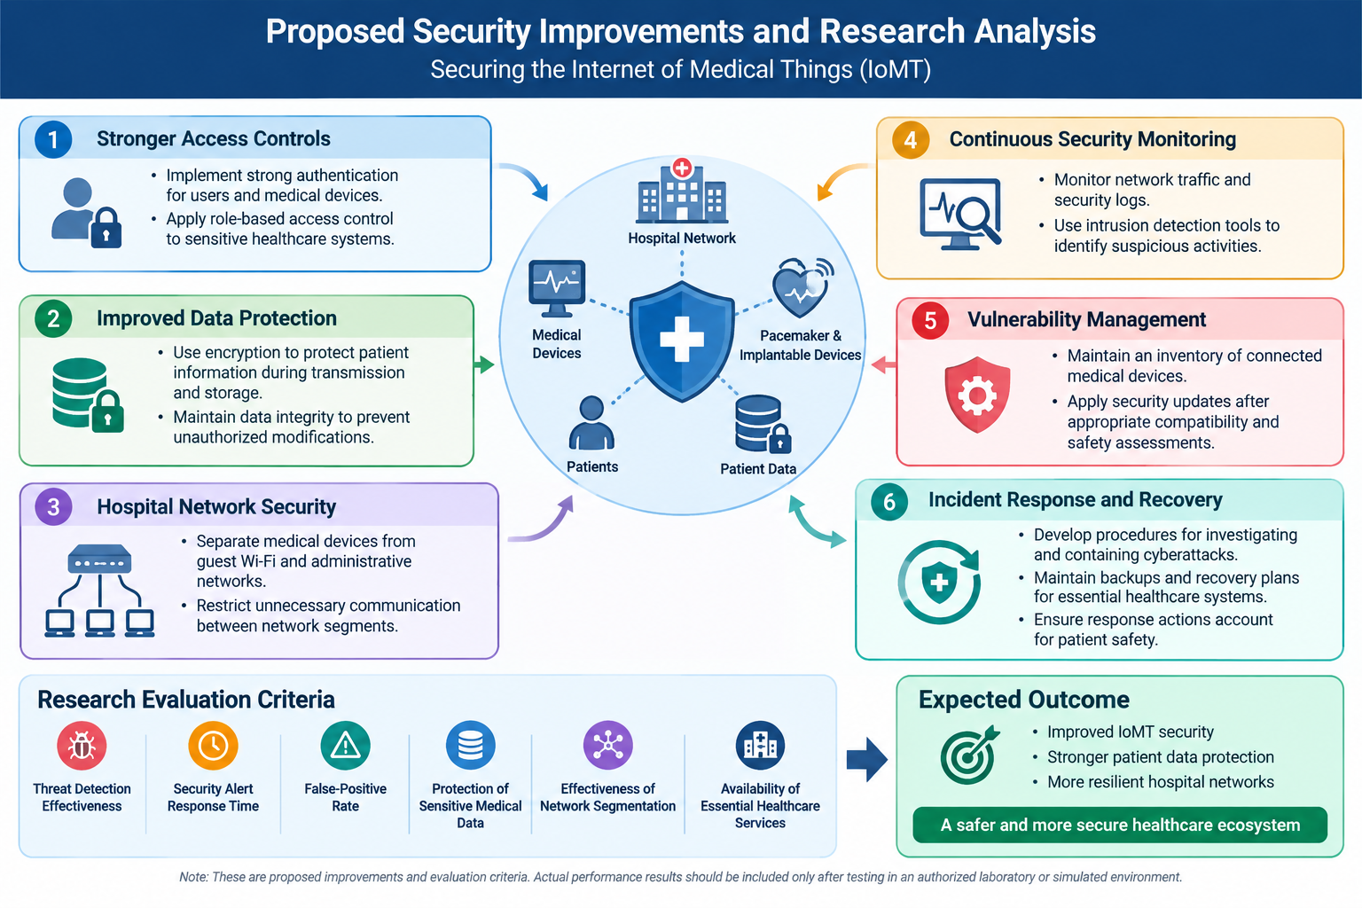
Aaditya Vishwakarma
Proposed Security Improvements and Research Analysis

Slide 10
Aaditya Vishwakarma
Conclusion
Securing the Internet of Medical Things (IoMT)
The Internet of Medical Things has transformed healthcare by enabling connected medical devices, remote patient monitoring, and efficient hospital operations. However, increasing connectivity also introduces cybersecurity risks that can affect patient privacy, medical device reliability, and healthcare services.
Key Findings
Device Security: Connected pacemakers and medical equipment require appropriate security controls to reduce unauthorized access.
Data Protection: Encryption and authentication help safeguard sensitive patient information.
Network Security: Network segmentation and continuous monitoring help reduce cybersecurity risks.
Threat Prevention: Security updates, intrusion detection, and incident response improve resilience against cyberattacks.
Patient Safety: Security measures must preserve the availability and safe operation of essential medical devices.
Final Conclusion
A layered cybersecurity approach combining authentication, encryption, network segmentation, monitoring, and incident response can strengthen IoMT security.

Slide 11
Aaditya Vishwakarma
THANK YOU
Aadityav1@duck.com

